Slide 1
Spam Filtering Using Bayesian Theorem
(Bayes' Theorem Approach and Naive Bayes Theorem Approach)
Akash Adak
IIT2022215

Slide 2
Objective: The purpose of this assignment is to implement Spam Filtering using
the following approaches: 1. Bayes' Theorem Approach 2. Naive Bayes Theorem Approach The models have been created from scratch without using any external libraries.
Naive Bayes Theorem Approach Trained a spam classifier using Naive Bayes Theorem. Performed tokenization, calculate word probabilities, and apply Laplace smoothing. Ensure the implementation can classify new emails based on the trained model.
Bayes' Theorem Approach Using Bayes' theorem to compute the probability of an email being spam or
not spam based on provided probabilities of evidence and prior distributions.
Data source: spam.csv

Slide 3
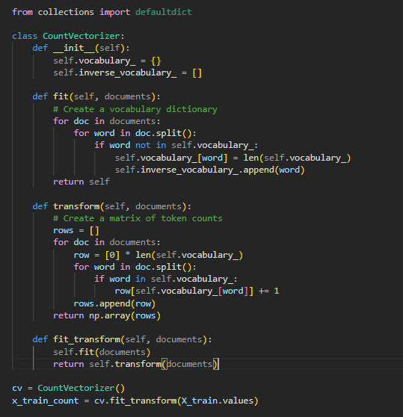
Performing Tokenization
Vocabulary Creation: The CountVectorizer
class tokenizes text by splitting it into words and assigning
each a unique index in vocabulary_.
Token Count Matrix: The transform method
generates a matrix where each row represents a document,
and each column represents word frequencies.
Combined Processing: The fit_transform
method performs both vocabulary creation and
matrix generation in one step.

Slide 4
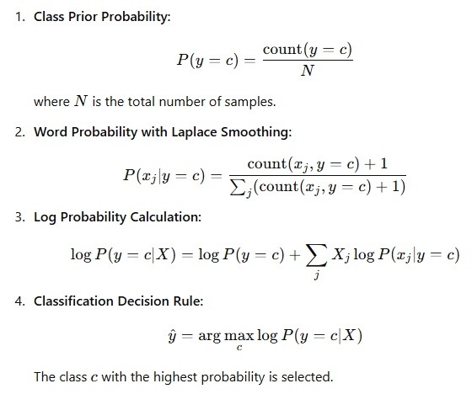
Naïve Bayes Theorem Formulation
This formulation represents how Naive Bayes calculates the log probabilities and applies Laplace smoothing.

Slide 5
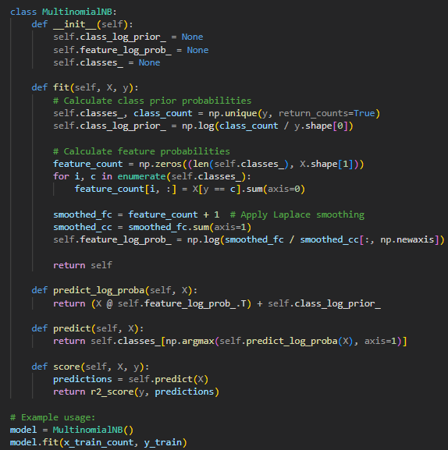
Applying Naïve Bayes Theorem
Calculating Word Probabilities: The model estimates
the probability of each word in different classes by
counting occurrences in the training data.
Applying Laplace Smoothing: To prevent zero
probabilities, 1 is added to all word counts before
normalizing, ensuring better generalization.
Prediction & Classification: The model calculates
log probabilities for each class and selects the one with
the highest score for classification.

Slide 6
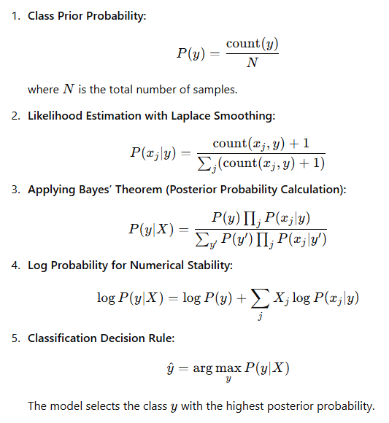
Bayes Theorem Formulation
This formulation clearly explains how Bayes’ theorem is applied in the model for classification.

Slide 7
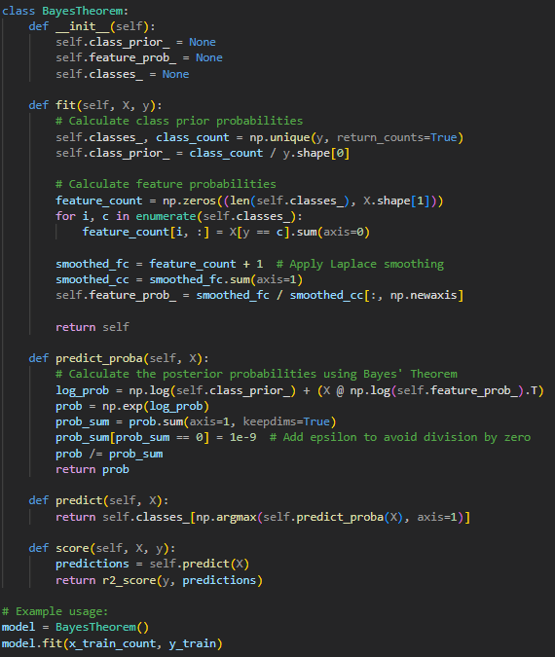
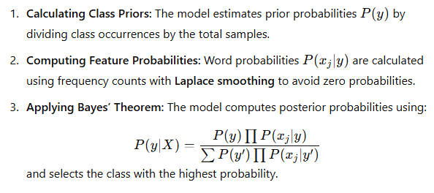
Applying Bayes’ Theorem

Slide 8
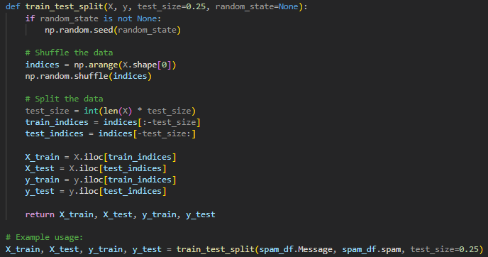
Other Important Implementations
1. Train – Test Split

Slide 9
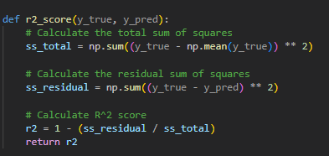
2. Implementing R2 Score

Slide 10
THANK YOU

